Slide 1
Individual app idea
1741124

Slide 2



Sign up
The Hub
Profile Page
User Name
Games
Facts
Weather-2013
Email
Weather Go!
Facts quiz
Achievements
Weather-2013@gmail.com
Total achievement points: 15 pts
Games
5
Completing weather game 1
The weather
Password
Facts
***********
5
Completing fact topics 1
Facts
5
Completing fact topics 2
FINISH
LOG OUT
Users will need to sign up in-order to use the app, it is a very simple signing up system which requires a user name, email address and a password.
The idea of this weather app is for it to be interactive, fun and educational whilst showing the weather forecast for age groups 6-12.
The profile page will consist of a list of achievements which can be obtained from the games and facts section. There is also an option to upload a profile picture but there will also be built in pictures that are related to the weather that can be used as a profile picture. There is also an option to log out.
On the top right you can click the icon to go to your profile page.

Slide 3

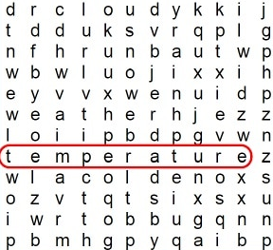

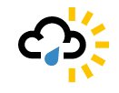
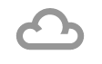
The weather
Games
Facts quiz
Crosswords
9°
Find the vocabulary:
Clear sky
True
False
Uxbridge
Tomorrow:
Monday:
Tuesday:
5. True of false? The most rain fall ever recorded in one year (Cherrapunji, India) is more than 30 meters.
Wednesday:
The weather page will show the current weather and future weather forecast, very similar to current weather forecast apps.
There is an arrow which takes the user back to the hub page.
The game page similar to the hub page will have different option of games. The user can pick a game of their choice. There is an arrow which takes the user back to the hub page.
The facts test page will test the users knowledge based on what they have learnt from the facts section, they will be tested 10 random questions in a multiple choice test of 4 options or true/false questions.
There is an arrow which takes the user back to the hub page.
Uxbridge
Search…..
London
Reading
There will be a drop down menu to select different areas and cites.

